Slide 1
Numpy

Slide 2
Reshaping arrays
Reshaping means changing the shape of an array.
The shape of an array is the number of elements in each dimension.
By reshaping we can add or remove dimensions or change number of elements in each dimension.

Slide 3
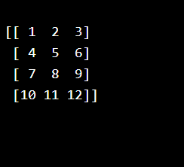
Reshape From 1-D to 2-D
ExampleGet y
Convert the following 1-D array with 12 elements into a 2-D array.
The outermost dimension will have 4 arrays, each with 3 elements:
import numpy as np arr = np.array([1, 2, 3, 4, 5, 6, 7, 8, 9, 10, 11, 12]) newarr = arr.reshape(4, 3) print(newarr)

Slide 4
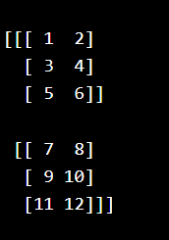
Reshape From 1-D to 3-D
Example
Convert the following 1-D array with 12 elements into a 3-D array.
The outermost dimension will have 2 arrays that contains 3 arrays, each with 2 elements:
import numpy as np arr = np.array([1, 2, 3, 4, 5, 6, 7, 8, 9, 10, 11, 12]) newarr = arr.reshape(2, 3, 2) print(newarr)

Slide 5
Unknown Dimension
You are allowed to have one "unknown" dimension.
Meaning that you do not have to specify an exact number for one of the dimensions in the reshape method.
Pass -1 as the value, and NumPy will calculate this number for you.

Slide 6
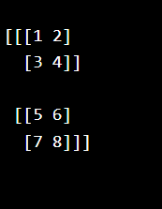
Example
Convert 1D array with 8 elements to 3D array with 2x2 elements:
import numpy as np arr = np.array([1, 2, 3, 4, 5, 6, 7, 8]) newarr = arr.reshape(2, 2, -1) print(newarr)

Slide 7
Flattening the arrays
Flattening array means converting a multidimensional array into a 1D array.
We can use reshape(-1) to do this.

Slide 8

Example
Convert the array into a 1D array:
import numpy as np arr = np.array([[1, 2, 3], [4, 5, 6]]) newarr = arr.reshape(-1) print(newarr)

Slide 9
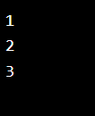
NumPy Array Iterating
Iterating means going through elements one by one.
As we deal with multi-dimensional arrays in numpy, we can do this using basic for loop of python.
If we iterate on a 1-D array it will go through each element one by one.
#Iterate on the elements of the following 1-D array:
import numpy as np arr = np.array([1, 2, 3]) for x in arr: print(x)

Slide 10

Iterating 2-D Arrays
import numpy as np arr = np.array([[1, 2, 3], [4, 5, 6]]) for x in arr: print(x)

Slide 11
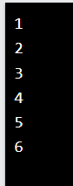
import numpy as np arr = np.array([[1, 2, 3], [4, 5, 6]]) for x in arr: for y in x: print(y)

Slide 12
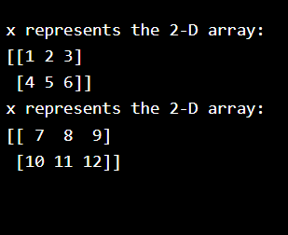
Iterating 3-D Arrays
In a 3-D array it will go through all the 2-D arrays.
import numpy as np arr = np.array([[[1, 2, 3], [4, 5, 6]], [[7, 8, 9], [10, 11, 12]]]) for x in arr: print(x)

Slide 13
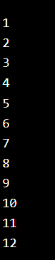
Iterate down to the scalars:
import numpy as np arr = np.array([[[1, 2, 3], [4, 5, 6]], [[7, 8, 9], [10, 11, 12]]]) for x in arr: for y in x: for z in y: print(z)

Slide 14

Iterating Arrays Using nditer()
import numpy as np arr = np.array([[[1, 2], [3, 4]], [[5, 6], [7, 8]]]) for x in np.nditer(arr): print(x)

Slide 15

Iterating With Different Step Size
We can use filtering and followed by iteration.
Example
Iterate through every scalar element of the 2D array skipping 1 element:
import numpy as np arr = np.array([[1, 2, 3, 4], [5, 6, 7, 8]]) for x in np.nditer(arr[:, ::2]): print(x)

Slide 16
import numpy as np arr = np.array([[1, 2, 3, 4], [5, 6, 7, 8]]) for x in np.nditer(arr[:, ::2]): print(x)

Slide 17
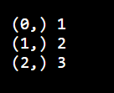
Enumerated Iteration Using ndenumerate()
numeration means mentioning sequence number of somethings one by one.
Sometimes we require corresponding index of the element while iterating, the ndenumerate() method can be used for those usecases.
Example
Enumerate on following 1D arrays elements:
import numpy as np arr = np.array([1, 2, 3]) for idx, x in np.ndenumerate(arr): print(idx, x)

Slide 18
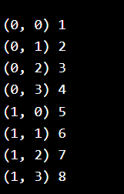
Example
Enumerate on following 2D array's elements:
import numpy as np arr = np.array([[1, 2, 3, 4], [5, 6, 7, 8]]) for idx, x in np.ndenumerate(arr): print(idx, x)

